Slide 1


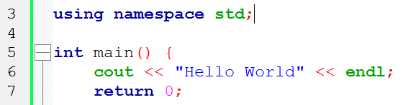
C++ Basic Syntax
The C++ Language, Data Types, Expressions, Console I/O
Zhivko Petrov
A guy that knows C++

Slide 2

Table of Contents
History, Concepts & Philosophy, Standards
C++ Structure, Compiling & Running C++ Code
Primitive Data Types in C++
Declaring & Initializing Variables, Scope
Operators, Expressions, Conditionals, Loops
Basic Console I/O

Slide 3
Questions
sli.do #cpp-softuni

Slide 4

What is C++?
Fast, Mid-level, Multi-Platform

Slide 5
What is C++
General purpose programming language
Compiles to binary – i.e. multi-platform
Statically typed – data types, classes, etc.
Multi-paradigm
Fast

Slide 6
C++ Philosophy
Features immediately useful in the real world
Programmers free to pick their own style
Useful features more important than preventing misuse
Features you do not use, you do not pay for
Programmer can specify undefined behavior
More: en.wikipedia.org/wiki/C++#Philosophy

Slide 7

C++ History
No, not this guy, sorry
Created 1979 – 1983 by Bjarne…

Slide 8
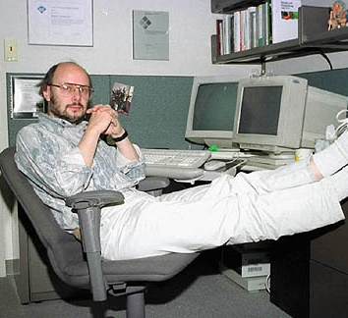
C++ History
This one! See, much better!
Psst! Hey, kids, want some Classes?
Created 1979 – 1983 by Bjarne…
… Stroustrup
Originally “C with Classes”

Slide 9
C++ Standards
C++ 98 – first standardized C++ version, C++ 03 – minor revision
C++ 11 – major revision, C++14 – revision with fixes
Many new features and improvements
Initializer lists, Rvalue references, lambdas, range-based loops, etc.
C++ 17 – latest official revision
C++ 20 – is being developed

Slide 10
C++ Compilers & IDEs
A C++ compiler turns C++ code to assembly
An IDE is software assisting programming
Has a Compiler, Linker, Debugger, Code Editor
Code organization, Tools, Diagnostics
There are lots of C++ compilers and IDEs
Free, open-source, proprietary

Slide 11
Code::Blocks
Free C & C++ IDE
Comes with MinGW GCC compiler
C++11 support needs to be enabled from settings
C++14 support needs more complicated setting to enable
Lightweight
Can compile single .cpp file
Can be used for bigger projects with many files, references, etc.

Slide 12
Program Structure, Running C++
Entry Point, Building and Running

Slide 13
Hello World
Here’s a classic C++ “Hello World” example
Include the input-output library
Say we’re working with the std namespace
1 #include <iostream>
2 using namespace std;
3
4 int main(int argc, char * argv[]) {
5 cout << "Hello World!" << endl;
6 return 0;
7 }
These are optional
Print to the console
"main" function – our entry point
For main, 0 means everything went ok

Slide 14
C++ Entry Point & Termination
The main function – entry point of the program
No other function can be named "main"
C++ needs specific function to start from
Everything else is free-form – code ordering, namings, etc.
Can receive command line parameters
Termination – main finishes (returns), the program stops
The return value of main is the "exit code“
0 means no errors – informative, not obligatory

Slide 15
Program Structure: Including Libraries
C++ has a lot of functionality in its standard code libraries
C++ can also use functionality from user-built code libraries
Say what libraries to use with the #include syntax
For now, for standard libraries: put the library name in <>
1 #include <iostream>
2 using namespace std;
3
4 int main(int argc, char * argv[]) {
iostream contains console I/O functionality

Slide 16
Program Structure: Blocks
Basic building block of a program
Most actual program code is in blocks, aka “bodies”
Start with { and end with }, can be nested
Functions’ (main()), loops’ & conditionals’ code is in blocks
int main(int argc, char * argv[])
{
5 cout << "Hello World!" << endl;
6 return 0;
7 }
main() code block

Slide 17
Program Structure: Statements & Comments
Statement: a piece of code to be executed
Blocks consist of statements
Statements contain C++ code and end with a ;
C++ has comments (parts of the code ignored by compiler)
// comments a line, /* starts a multi-line comment, */ ends it
A statement
int main(int argc, char * argv[])
{
5 cout << "Hello World!" << endl;
6 return 0;
7 }
Another statement (Note: usually 1 per line)

Slide 18
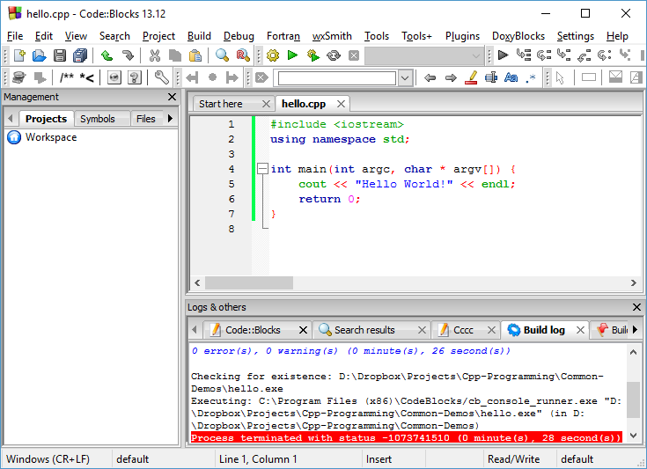
C++ Hello World
Live Demo

Slide 19
Variables & Primitive Types
Types, Declaration, Initialization, Scope

Slide 20
Fast Intro: Declaring and Initializing Variables
<data_type> <identifier> [= <initialization>];
Declaring: int num;
Initializing: num = 5;
Combined: int num = 5, and additionally int num(5); or int num{5}; (C++11)
Can declare multiple of same type by separating with comma (,)
int trappist1BMassPct=85, trappist1CMassPct=80;
NOTE: int num() is not a default initialization – it’s a function declaration.

Slide 21
Declaring & Initializing Variables
LIVE DEMO

Slide 22
Quick Quiz
Tony gives George 5 apples
Later, Angus gives George 3 apples
How many apples does George have?
TIME:

Slide 23
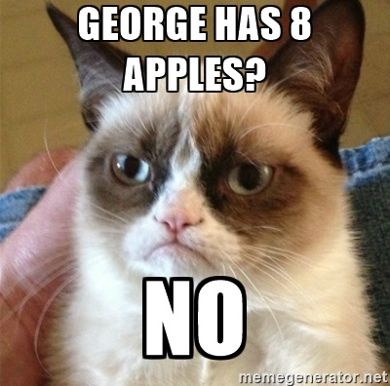
C++ Pitfall: UnInitializED Locals
George has 13837 apples.
Why?
Nobody said George had 0 apples to begin with.

Slide 24
Uninitialized Locals
LIVE DEMO

Slide 25
Local & Global Variables
Global: defined outside blocks, usable from all code
Local: defined inside blocks, usable only from code in their block
Locals DO NOT get initialized automatically
Globals get initialized to their “default” value (0 for numerics)
int secondsInMinute = 60;
int minutesInHour = 60;
int hoursInDay = 24;
int secondsInHour = secondsInMinute * minutesInHour;
int main() {
int days = 3;
int totalSeconds = days * hoursInDay * secondsInHour;

Slide 26
Global & Local Variables
LIVE DEMO

Slide 27
const Variables
C++ supports constants – “variables” that can’t change value
Can and MUST receive a value at initialization, nowhere else
Can be local, can be global
secondsInMinute, minutesInHour, etc., aren’t things that normally change in the real world – the following won’t compile:
NOTE: the const keyword has other uses which we’ll discuss later on
const int secondsInMinute = 60;
int main() {
secondsInMinute = 13; //compilation error

Slide 28
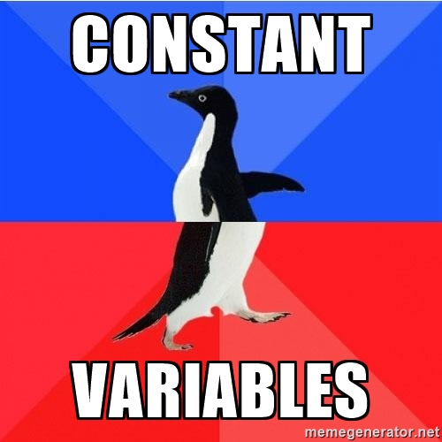
const Variables
LIVE DEMO

Slide 29
Other variable modifiers
static variables initialize once and exist throughout program
Can be used to make a local variable that acts like a global one
Can be used on a global variable, but has no real effect
extern tells the compiler a variable exists somewhere in a multi-file project (to avoid multi-declaration)

Slide 30
Primitive Data Types
Integer, Floating-point and Symbolic values

Slide 31
Integer Types – int
C++ has “only one” integer type – int
“Width” modifiers control the type’s size and sign
short – at least 16 bits; long – at least 32 bits
long long – 64 bits (C++11, Windows supports it on C++03 too)
signed & unsigned – use or not use memory for sign data
Modifiers can be written in any order
int can be omitted if any modifier is present

Slide 32
Integer Sizes and Ranges
The C++ standard doesn’t have very strict size guarantees
int is 32-bits on most mainstream PCs
Use sizeof(int) to get the size (in bytes) on your system
Ranges depend on size, a 32-bit integer has about 4 billion values
So, a signed 32-bit integer has the range of about (-2 billion, +2 billion)
Average human lifespan = 2 billion seconds. int is older than you!
Sizes: http://en.cppreference.com/w/cpp/language/types#Properties
Ranges: http://en.cppreference.com/w/cpp/language/types#Range_of_values

Slide 33
Integer Types
LIVE DEMO

Slide 34
Floating-Point Types
Represent real numbers (approximations)
2.3, 0.7, -Infinity, -1452342.2313, NaN, etc.
float: single-precision floating point, usually IEEE-754 32-bit
double: double-precision, usually IEEE-754 64-bit
Name | Description | Size* | Range*
float | Floating point number. | 4bytes | ±1.5 × 10⁻⁴⁵ to ±3.4 × 10³⁸ (~7 digits)
double | Double precision floating point number. | 8bytes | ±5.0 × 10⁻³²⁴ to ±1.7 × 10³⁰⁸ (~15 digits)
long double | Long double precision floating point number. | 8bytes | ±5.0 × 10⁻³²⁴ to ±1.7 × 10³⁰⁸ (~15 digits)

Slide 35
Using Floating-Point Types
LIVE DEMO

Slide 36
Guaranteeing Type Sizes
C++ has some cross-platform support for fixed-size types
There is the C++11 bitset, the cstdint library, etc.
Code running on most systems has access to system macros
E.g. on Windows: INT32, INT8, FLOAT, INT_PTR, LONG_PTR
Universally-portable code with fixed sizes is not really possible
Do you really expect a toaster to guarantee a 64-bit integer?
In most cases, type-size guarantees are not necessary

Slide 37

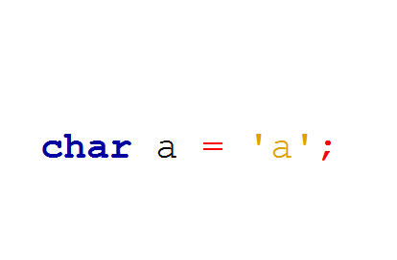
char
No, not this char
The C++ char

Slide 38
Character Types – char
char is the basic character type in C++
Basically an integer interpreted as a symbol from ASCII
Guaranteed to be 1 byte – a range of 256 values
Initialized by either a character literal or a number (ASCII code)
int main() {
char letter = 'a';
char sameLetter = 97;
char sameLetterAgain = 'b' - 1;
cout << letter << sameLetter << sameLetterAgain << endl;
return 0;
}

Slide 39
Using char as a Number
char is essentially a 1-byte integer, it can be used as such
char is also useful when processing data byte-by-byte
Use signed or unsigned when using char as a number
Guarantees range of char as [-128, 127] or [0, 255]
Otherwise the system decides what's best for characters
… you don’t want the system pretending to be smart
Avoid using char as a number unless you have a good reason to

Slide 40
Using Character Types
LIVE DEMO

Slide 41
Boolean Type – bool
bool – a value which is either true or false, takes up 1 byte
Takes true, false, or numeric values
Any non-zero numeric value is interpreted as true
Zero is interpreted as false
int main() {
bool initializedWithKeyword = true;
bool initializedWithKeywordCtor(false);
bool initializedWithZero = 0;
bool initializedWithNegativeNumber(-13);

Slide 42
Using Boolean Types
LIVE DEMO

Slide 43
Implicit & Explicit Casting
Types which “fit” into others can be assigned to them implicitly
For integer types, “fit” usually means requiring less bytes
Valid: char a = ‘a’; int i = a;
NOT VALID: int i = 97; char a = i;
For floating point, float fits into double
If you really want to store a “bigger” type in a “smaller” type:
Explicitly cast the “bigger” type to the “smaller” type: smallType smallVar = (smallType) bigVar;
Can lose accuracy if value can’t be represented in “smaller” type

Slide 44
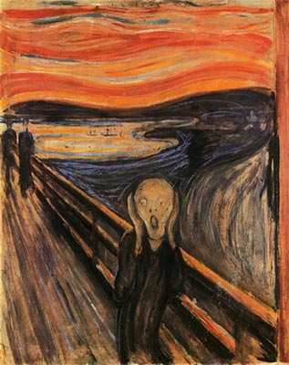

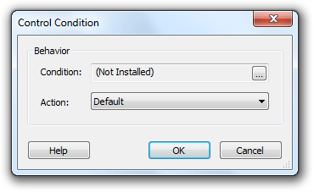

Expressions, Operators, Conditionals, Loops,
Literals, if, switch, else, for, while

Slide 45
C++ Numeric Literals
Represent values in code, match the primitive data types
Integer literals – value in a numeral system
Floating-point literals – decimal OR exponential notation
Suffix to describe precision (single or double-precision)
unsigned long long num;
num = 5; num = -5; num = 5L; num = 5ULL; num = 0xF;
double num;
num = .42; num = 0.42; num = 42e-2;
float floatNum;
floatNum = .42f; floatNum = 0.42f; floatNum = 42e-2f;

Slide 46
Non-Numeric Literals
Character literals – letters surrounded by apostrophe (')
String literals – a sequence of letters surrounded by quotes (")
Boolean literals – true and false
char letter = 'a';
cout << "Hello World!" << endl;
bool cppIsCool = true;

Slide 47
C++ Literals – Things to Keep in Mind
Integers are positive – writing a - does a minus operation
Integers should be suffixed if they are too large for a simple int
Compiler might try to extend automatically, but don’t rely on it
Floating-points are double by default, suffix with f for float
#include<iostream>
using namespace std;
int main() {
cout << -42 << " " << 052 << " " << 0x2a << " " << 0x2A << endl
<< 0.42 << " " << .42f << " " << 42e-2 << endl;
}

Slide 48
C++ Literals
LIVE DEMO

Slide 49
Expressions and Operators
Operators in C++ are similar to those in other languages
Operators perform actions on one or more variables/literals
Can be customized for different behavior based on data type
C++ operator precedence and associativity table: http://en.cppreference.com/w/cpp/language/operator_precedence
Don’t memorize. Use brackets or check precedence when needed
Expressions: literals/variables combined with operators/functions

Slide 50
Commonly Used C++ Operators
Category | Operators
Arithmetic | + | - | * | / | % | ++ | --
Logical | && | || | ^ | !
Binary | & | | | ^ | ~ | << | >>
Comparison | == | != | < | > | <= | >=
Assignment | = | += | -= | *= | /= | %= | &= | |= | ^= | <<= | >>=
String concatenation | +
Other | . | [] | () | a?b:c | new | delete | * | -> | :: | (type) | << | >>

Slide 51
C++ Operators & Expressions
LIVE DEMO

Slide 52
Conditionals
The if-else statement takes in a Boolean expression
If the expression evaluates to true, the if block is executed
If the expression evaluates to false, the else block is executed
The else block is optional
Block { } brackets can be omitted if only 1 statement
double value1 = 5 * 5 / 2.f, value2 = 5 * 5 / 2;
if (value1 > value2) {
cout << "value1 is larger" << endl;
} else {
cout << "value2 is larger" << endl;
}

Slide 53
“Chaining” if-else
Can “chain” several checks one after the other
The code below is equivalent. Each else block contains 1 “If” statement, so they don’t need brackets. The left variant skips the brackets
if (value1 > value2) {
cout << "value1 is larger";
} else if (value1 == value2) {
cout << "values are equal";
} else {
cout << "value2 is larger";
}
if (value1 > value2) {
cout << "value1 is larger";
} else {
if (value1 == value2) {
cout << "values are equal";
} else {
cout << "value2 is larger";
}
}

Slide 54
Quick Quiz
TIME:
What will this code print out to the console?
#include<iostream>
using namespace std;
int main() {
int a = 5;
int aMod3 = a % 3;
if (a = aMod3) {
cout << "equal" << endl;
} else {
cout << "not equal" << endl;
}
return 0;
}

Slide 55
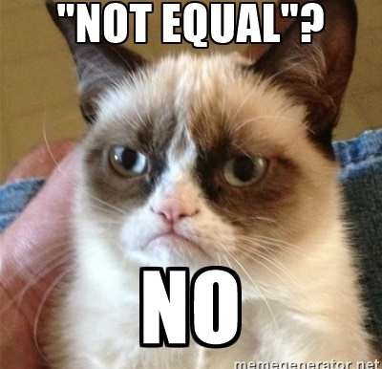
C++ Pitfall: Assignment instead of comparison in conditional
Check the code again.
The expression in the if is not the == check, it is the = assignment,
Which here is non-zero, evaluates to true, so we go in the if block

Slide 56
if and if-else
LIVE DEMO

Slide 57
switch-case
Example of C++ switch-case usage
switch (day)
{
case 1: cout << "Monday"; break;
case 2: cout << "Tuesday"; break;
case 3: cout << "Wednesday"; break;
case 4: cout << "Thursday"; break;
case 5: cout << "Friday"; break;
case 6: cout << "Saturday"; break;
case 7: cout << "Sunday"; break;
default: cout << "Error!"; break;
}

Slide 58
switch-case structure
The C++ switch statement takes in
An integer expression OR an enumeration type
OR something which converts to an int (like char)
The case block can contain case labels and any other code
Each label has an expression of the same type as the switch
The case block can also contain the break statement
If reached, code continues from after the case block
There is a special default label (without an expression)

Slide 59
switch-case execution
switch evaluates the expression and finds the matching case
Any code before the matching case is skipped
Any code after the matching case is executed
Until break or the end of the block is reached
Without break, labels after the matching one will be executed!
If there is no matching case
If the block contains the special default label, it is executed
Otherwise the case block is skipped

Slide 60
switch-case
LIVE DEMO

Slide 61
for Loop
for([init]; [condition]; [increment]) {…}
The init statement can declare and initialize variables
Declared variables are usable only IN the for’s body
The loop runs while the condition statement is true
increment is executed AFTER the for’s body
Can execute any expression
Expressions inside init and increment are separated by comma (,)

Slide 62
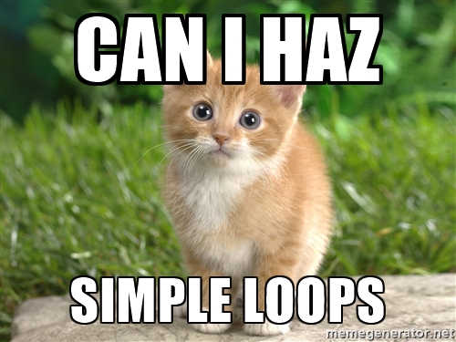
Fibonacci with “Empty” for Loop
Every time you do something like this, a kitten dies
int currentNum = 1;
for(int i = 2, lastNum = 1, newCurrent;
i < fibonacciToCalculate;
i++, newCurrent = lastNum + currentNum,
lastNum = currentNum, currentNum = newCurrent)
{ }
cout << currentNum << endl;

Slide 63
for Loop
LIVE DEMO

Slide 64
while and do-while Loops
while (condition) { body code; }
Executes until condition becomes false, may never execute
do { body code; } while (condition);
First executes body, then checks condition
Guaranteed to execute at least once
int age = 0;
while (age < 18) {
cout << "can't drink at age " << age << endl;
age++;
}
cout << "age " << age << ", can finally drink!" << endl;

Slide 65
while and do-while Loops
LIVE DEMO

Slide 66
Loops
C++ loop control keywords:
break – interrupts the loop and continues after its block
continue – the current iteration skips the remaining part of the loop block
C++11 also added a range-based for loop
We’ll discuss it in the lecture on arrays

Slide 67
Basic Console I/O
Writing to and Reading from the Console

Slide 68
C++ Streams 101
Things (classes) that either read or write data piece by piece
Example: we’ve been using cout throughout this lecture
Writes data to the console (standard output)
cout has a counterpart – cin
Reads data from the console (standard input)
cin uses the >> operator to read
cout uses the << operator to write
#include<iostream>
using namespace std;
int main() {
int a, b;
cin >> a >> b;
cout << a + b << endl;
return 0;
}

Slide 69
Reading (Multiple) Numeric Values with cin
Expects console data to mostly match variable type literals
Expects input data to be separated by one or more spaces/lines
For integer types, a sequence of digits is expected
Can have sign, can NOT have type suffix (i.e. NO L, ULL, etc.)
For floating-point types:
Can be an integer
Can be a sequence of digits separated by “.”
Can be exponential notation (e.g. 0.42e+2 will be read as 42)

Slide 70
Reading Multiple Numbers
LIVE DEMO

Slide 71
Summary
C++: fast, statically-typed, imperative, multi-paradigm language
Integer types – int with modifiers for size and sign
Size: long, short; Sign: signed, unsigned
Size in bytes depends on system
Floating point types – float and double, following IEEE754
if-else and switch-case allow code branching
for, while, do-while allow repeat-execution of code
Use cin >> / cout << for reading from/writing to console

Slide 72
https://softuni.bg/trainings/courses

Slide 73












SoftUni Diamond Partners

Slide 74




SoftUni Organizational Partners

Slide 75




Trainings @ Software University (SoftUni)
Software University – High-Quality Education and Employment Opportunities
softuni.bg
Software University Foundation
http://softuni.foundation/
Software University @ Facebook
facebook.com/SoftwareUniversity
Software University Forums
forum.softuni.bg

Slide 76
License
This course (slides, examples, demos, videos, homework, etc.) is licensed under the "Creative Commons Attribution-NonCommercial-ShareAlike 4.0 International" license

